Slide 1





Python to C error detector
C Project

Slide 2
Table of
Content
Concept
Demonstration
Code Description
Output
Conclusion
Team

Slide 3
CONCEPT

Slide 4

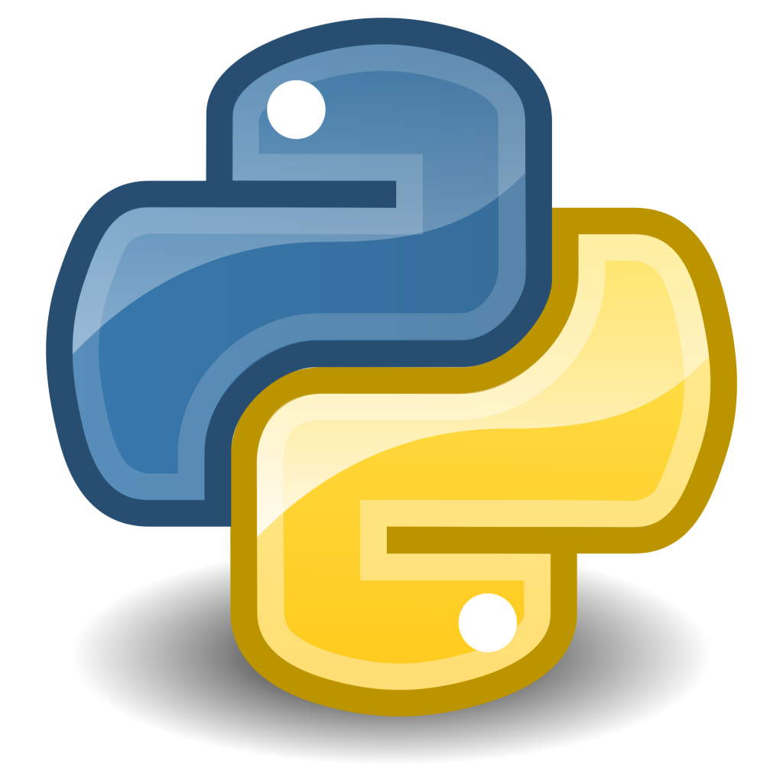
Introduction
Python, a widely-used programming language known for its simplicity and readability.
Syntax errors are common even for experienced Python programmers.
The "Python Error Detector" project addresses this challenge by automating the detection of these errors.

Slide 5

Objective
The main goal of this project is to develop a tool that automates the detection of common Python syntax errors.
The tool analyzes Python code line by line and provides feedback on potential errors to improve code quality and prevent runtime errors.

Slide 6

Key Features
Automated Error Detection
User-Friendly Interface
Easy to use
Common Error Checks
Custom Error Checks

Slide 7

How It Works!
@reallygreatsite

Slide 8
Error Detection
Input
Step1
Step 2
The user provides the Python program file as input to the Python Error Detector via the command line.
The tool reads the Python program line by line.
It checks each line for common syntax errors using predefined and custom error checks.
Error Reporting
Output
Step 3
Step 4
If an error is detected, the tool records the error message and the line number in an error log.
After analyzing the entire program, the Python Error Detector displays a summary of errors found.
The user can review the errors and make necessary corrections.

Slide 9

Benefits
Improved Code Quality: By catching common syntax errors early in the development process, developers can write more reliable Python code.
Time Savings: The tool accelerates the debugging process by pinpointing errors quickly.
Learning Aid: It serves as an educational tool for programmers learning Python, helping them understand common pitfalls.

Slide 10

Future Enhancement
Future enhancements could include more advanced error detection techniques, integration with code editors and IDEs, and support for a wider range of Python versions

Slide 11
DEMONSTRATION

Slide 12

Live Demo

Slide 13

Code Description
Initialization and Error Data Structure
Error Addition Function
Main Function and file handling
Error Detection and Reporting
Error printing and clean up
@reallygreatsite

Slide 14
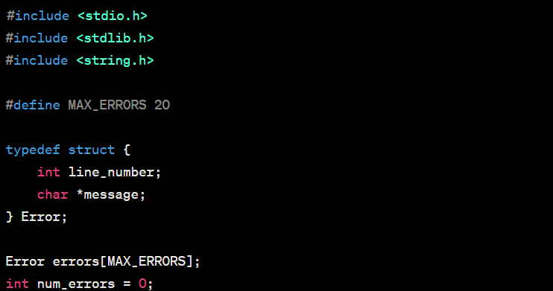
Initialization and Error Data Structure
This part includes the initialization of data structures and defines the Error data structure to store error information.

Slide 15
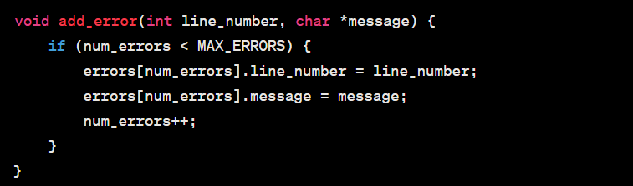
Error Addition Function
This part contains the add_error
function, which allows errors to be
added to the errors array.

Slide 16
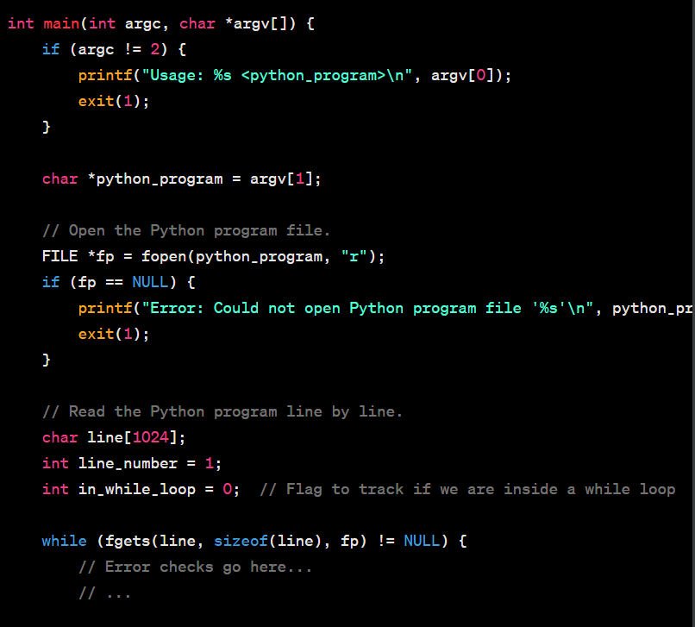
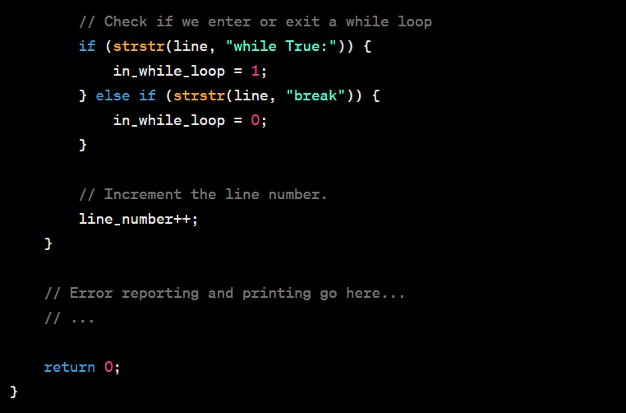
Main Function and file handling
This part includes the main function, which handles command-line arguments,
opens the Python program file, and reads it line by line.

Slide 17
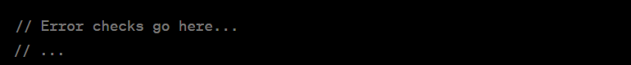
Initialization and Error Data Structure
This part of the code contains various error detection checks for common Python syntax errors. Additional checks can be added as needed.

Slide 18
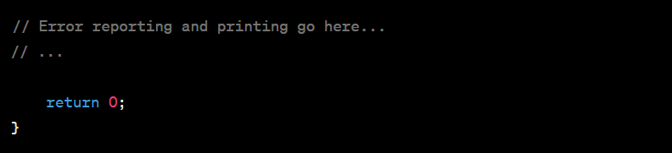
Error Printing and Clean Up.
This part handles the printing of any errors that were found in the Python program and performs cleanup before exiting the program.

Slide 19
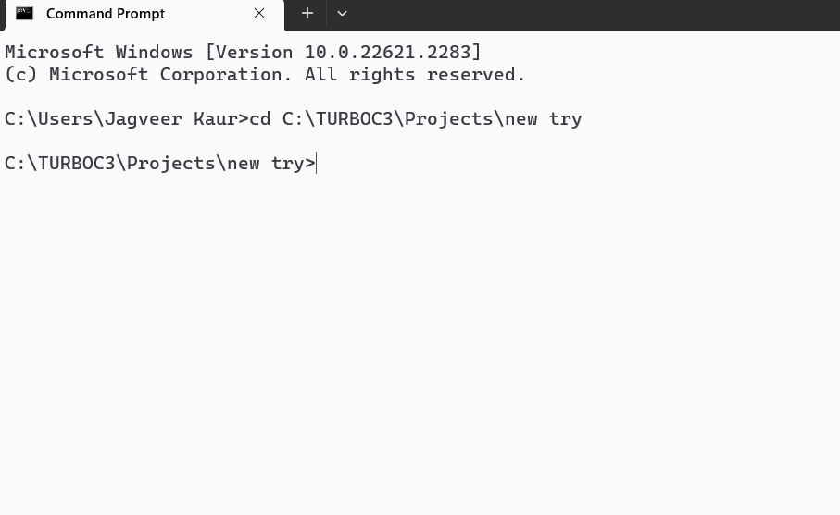
Steps to be followed by user.
Step 1: User need to open the command prompt and change the directory to that directory where all the python files and c source (main) file for error checking is saved. IMPORTANT: All the files should be in the same directory.

Slide 20
Step 2: User need to open the command prompt and change the directory to that directory
where all the python files and c source (main) file for error checking is saved.
IMPORTANT: All the files should be in the same directory.

Slide 21
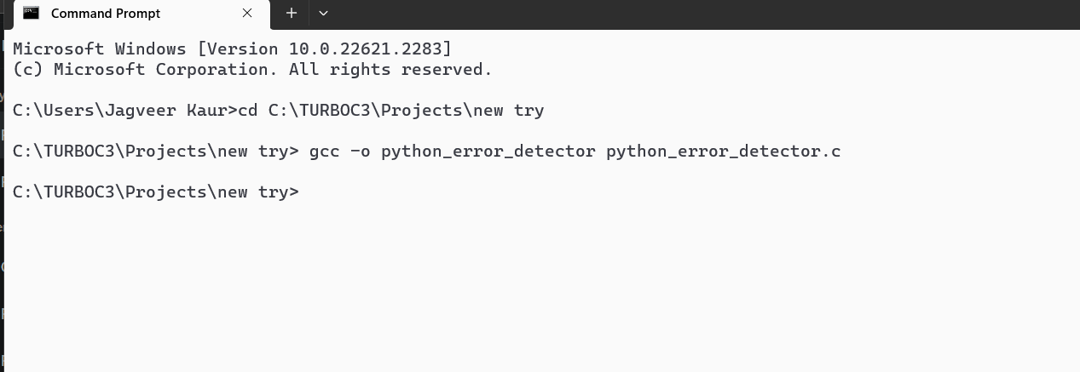
Steps to be followed by user.
Compile your C code to create an executable file. Open your command prompt and navigate to the directory containing your C code file (e.g., python_error_detector.c).
Step 3 :

Slide 22
The command gcc -o python_error_detector python_error_detector.c is used to compile your C code and create an executable file named python_error_detector.
Let's break down the components of this command:
gcc: This is the GNU Compiler Collection, a widely-used compiler for the C and C++ programming languages. It's the compiler that will be used to compile your C code.
-o error_detector: The -o option specifies the name of the output file. In this case, it specifies that the output should be named error_detector. You can choose any name you like for your executable, but it's common to use a name that reflects the purpose of the program.
error_detector.c: This is the name of your C source code file that you want to compile.
So, when you run gcc -o error_detector error_detector.c, you're telling the compiler to take the error_detector.c source code and compile it into an executable named error_detector. This allows you to run your C program using the ./error_detector command in the command prompt.
In summary, the gcc command with the -o option is used to compile your C code and specify the name of the resulting executable file.
“gcc –o python_error_detector python_error_detector.c”

Slide 23
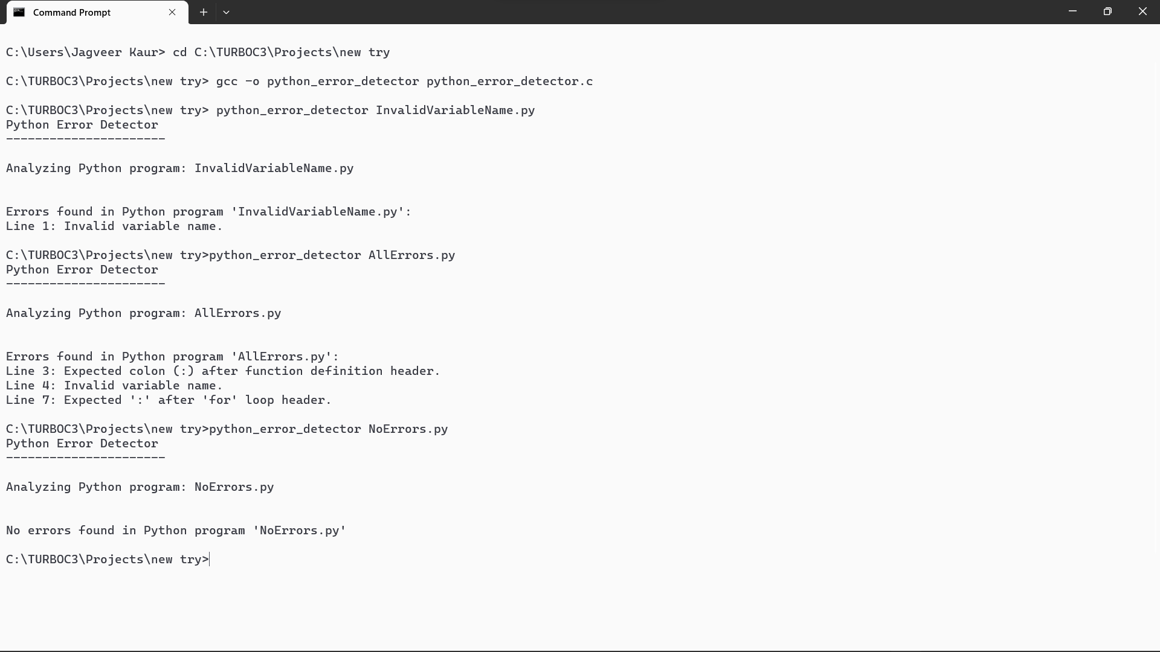
Step 4: Run the Python Error Detector: Once you have successfully compiled the code, you can run
the Python Error Detector by providing the Python program file you want to analyze as a command-line
argument.
Ex: python_error_detector *your_python_file_name.py*

Slide 24
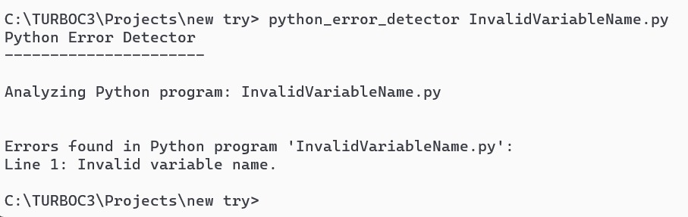
Step 5:
View the Output:
The Python Error Detector will analyze the Python program and display the
results in the command prompt. You'll see error messages, if any, along with their line numbers.

Slide 25
Python Compiler!

Slide 26
Steps to build a python compiler

Slide 27
1. Understanding Python's Grammar and Semantics:
Start by thoroughly understanding the Python language's grammar and semantics. Python's official documentation and the Python Language Reference are valuable resources.
2. Lexer (Lexical Analysis):
Implement a lexer to break down Python source code into tokens. Tokens are the smallest units of code (e.g., keywords, identifiers, operators).
3. Parser (Syntax Analysis):
Create a parser that processes the tokens generated by the lexer and builds an Abstract Syntax Tree (AST). The AST represents the structure of the Python program.
4.Semantic Analysis:
Implement semantic analysis to check for type compatibility, variable scoping, and other language-specific rules. This step ensures that the code is semantically correct.
5. Intermediate Representation (IR):
Convert the AST into an intermediate representation, which is a lower-level representation of the code. Common choices for the IR include Abstract Syntax Trees (ASTs), Three-Address Code (TAC), or bytecode.
6. Code Generation:
Generate machine code or assembly code from the intermediate representation. This step involves translating Python code into a format that can be executed by a computer's CPU.

Slide 28
7. Runtime Environment:
Create a runtime environment that includes memory management, a stack for function calls, and a garbage collector if necessary.
8. Standard Library:
Implement a subset of Python's standard library functions to provide essential functionality to the compiled programs.
9. Testing and Debugging:
Extensively test your compiler by compiling and running Python code, starting with simple programs and gradually increasing complexity. Implement debugging features to help identify and fix issues.
10. Optimization (Optional):
Consider implementing optimization techniques to improve the performance of the generated code. This can include techniques like dead code elimination, constant folding, and loop unrolling.
11. Documentation:
Document your compiler's usage, architecture, and any specific features or limitations.
12. Packaging and Distribution:
If desired, package your Python compiler into a distributable form, so others can use it.
13. Community and Collaboration:
Consider open-sourcing your project and collaborating with the Python community to get feedback and contributions.

Slide 29
Live Demo

Slide 30
CONCLUSION

Slide 31

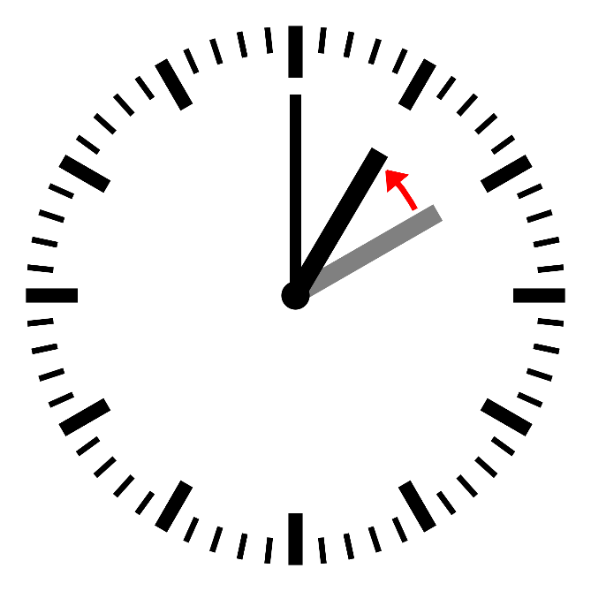
In conclusion, the Python Error Detector project represents a significant step forward in enhancing the Python programming experience. With the ever-increasing adoption of Python across various domains, ensuring code quality and correctness is paramount. This project not only addresses common syntax errors but also streamlines the debugging process, providing several key benefits:
Improved Code Quality: By automating the detection of common Python syntax errors,
the Python Error Detector empowers developers to write cleaner and more reliable code.
This, in turn, reduces the likelihood of encountering runtime errors and enhances the
overall robustness of Python programs.
Time Savings: The automation provided by this tool significantly reduces the time and
effort required for manual error detection and debugging. Developers can focus more
on writing code and less on identifying and fixing syntax issues.

Slide 32


Educational Value: Beyond its utility for seasoned developers, the Python Error Detector serves as a valuable
educational tool for learners and beginners in Python programming. It provides immediate feedback and insights
into common errors, helping users grasp Python's syntax rules more effectively.
As we look to the future, there are exciting possibilities for expanding the capabilities of this project. Advanced error detection techniques, integration with popular Integrated Development Environments (IDEs), and support for additional Python versions and libraries are just a few avenues for potential enhancements.

Slide 33






TEAM
Jagveer Disha Manasvi Prachi
Developer Custom Error Check Developer Quality Assurance Tester Developer
Sahil Bharath
Custom Error Check Developer Quality Assurance Tester

Slide 34



